Slide 1
COMPUTER ORGANIZATION AND ARCHITECTURE
Dr. Rizwan Khan
Head – Department of Computer Science and Engineering
(An NBA Accredited Program)
ABES Institute of Technology, Ghaziabad

Slide 2
MODES OF TRANSFER - INTERRUPT INITIATED I/O & DMA
Modes of Transfer
Interrupt Initiated I/O
Polling takes valuable CPU time
Open communication only when some data has to be passed -> Interrupt.
I/O interface, instead of the CPU, monitors the I/O device
When the interface determines that the I/O device is ready for data transfer, it generates an Interrupt Request to the CPU
Upon detecting an interrupt, CPU stops momentarily the task it is doing, branches to the service routine to process the data transfer, and then returns to the task it was performing
DMA (Direct Memory Access)
Large blocks of data transferred at a high speed to or from high speed devices, magnetic drums, disks, tapes, etc.
DMA controller
Interface that provides I/O transfer of data directly to and from the memory and the I/O device
CPU initializes the DMA controller by sending a memory address and the number of words to be transferred
Actual transfer of data is done directly between the device and memory through DMA controller
Freeing CPU for other tasks

Slide 3
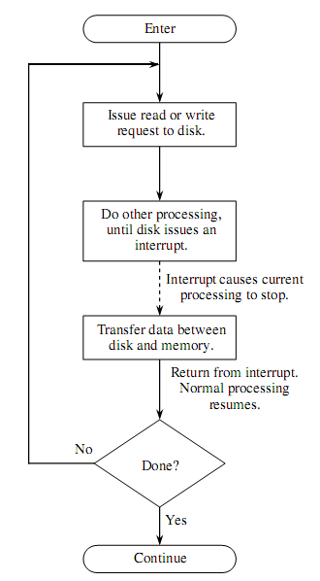
Interrupt Driven I/O
Interrupt Service Routine (ISR)
Vectored Interrupt
Non-vectored Interrupt
Priority of Interrupts
Maskable Interrupts
Non Maskable Interrupts

Slide 4
Interrupts and ISR
Priority Interrupt
In a number of conditions the processor may be interrupted from its normal processing activity. Some of these conditions are :
Power failure as detected by a sensor
Arithmetic conditions such as overﬂow and underﬂow
Illegal data or illegal instruction code
Errors in data transmission and storage
Software-generated interrupts (as intended by the user)
Normal completion of asynchronous transfer.
An interrupt service routine is a program preloaded into the machine memory that performs the following functions:
Disables further interrupts temporarily.
Saves the processor status (all registers).
Enables further interrupts.
Determines the cause of interrupt.
Services the interrupt.
Disables interrupts.
Restores processor status.
Enables further interrupts.
Returns from interrupt.

Slide 5
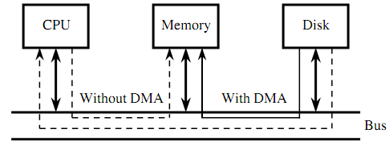
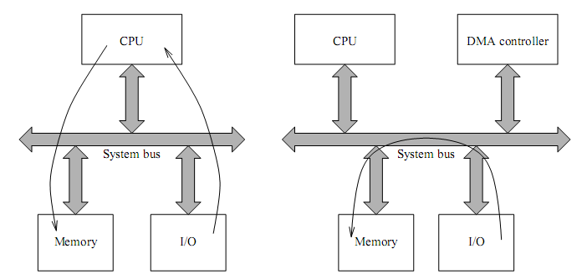
Direct Memory Access

Slide 6
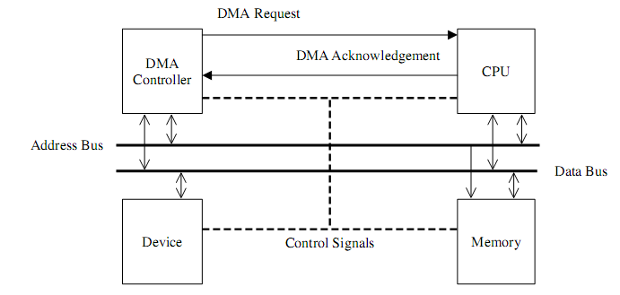
Direct Memory Access
The DMA controller is a piece of hardware that controls one or more peripheral devices. It allows devices to transfer data to or from the system’s memory without the help of the processor. In a typical DMA transfer, some event notiﬁes the DMA controller that data needs to be transferred to or from memory. Both the DMA and CPU use memory bus and only one or the other can use the memory at the same time. The DMA controller then sends a request to the CPU asking its permission to use the bus. The CPU returns an acknowledgment to the DMA controller granting it bus access. The DMA can now take control of the bus to independently conduct memory transfer. When the transfer is complete the DMA relinquishes its control of the bus to the CPU.

Slide 7
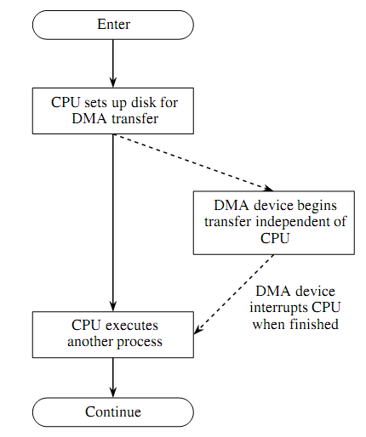
Direct Memory Access

Slide 8
Typical DMA Operation
The processor initiates the DMA controller by identifying the I/O device and supplying the memory address, byte count, and type of operation (input or output). This is referred to as channel initialization. Once initialized, the channel is ready for data transfer between the associated I/O device and memory.
When the I/O device is ready to transfer data, it informs the DMA controller. The DMA controller starts the transfer operation. This step consists of the following substeps.
Obtain the bus by going through the bus arbitration process
Place the memory address and generate the appropriate read and write control signals;
Complete the transfer and release the bus for use by the processor or other DMA devices;
Update the memory address and count value;
If more bytes are to be transferred, repeat the loop from Step (a).
After completing the operation, the processor is notiﬁed. This notiﬁcation is done by an interrupt mechanism. The processor can then check the status of the transfer (i.e., successful or failure).

Slide 9


